Slide 1
The predictive power of public Twitter sentiment for Bitcoin prices using Python
Student:
Mohsen Selseleh
Winter 2022

Slide 2
Introduction
The machine learning algorithms has shown many great results in a wide variety of fields. Natural language processing is one of them, and it is one of those fields where machine learning has been able to show artificial intelligence achieving some important results for a lot of complicated tasks. Sentiment analysis or opinion mining is one of the major tasks of NLP (Natural Language Processing). In this paper, I aim to tackle the problem of sentiment polarity categorization, which is one of the fundamental problems of sentiment analysis. A general process for sentiment polarity categorization is proposed with detailed process descriptions.

Slide 3
Cryptocurrencies have become a very popular topic recently, primarily due to their disruptive potential and reports of unprecedented returns. In addition, academics increasingly acknowledge the predictive power of Twitter for a wide variety of events and more specifically for financial market.

Slide 4
The problem statement
The problem is that we have text files in which multiple tweets of Bitcoin stored. So first we need to do sentiment analysis on each tweet and create sentiment of each tweet. After that we need build Machine Learning models.

Slide 5
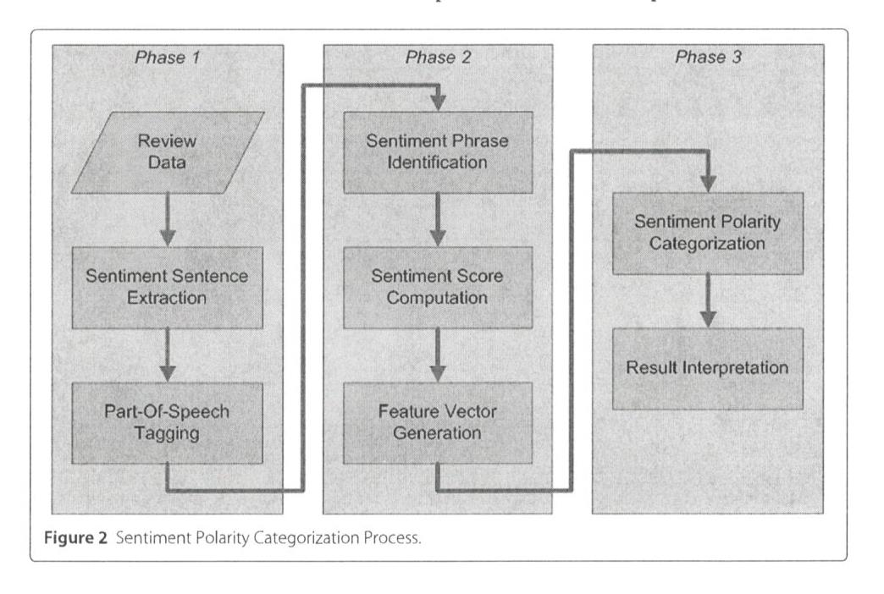
The technique:categorization of sentiment polarity.

Slide 6
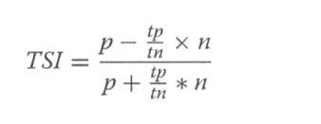
namely TSI (Total Sentiment Index), featuring itself as a positive token or a negative token. Specifically, a TSI for a certain token is computed as:
where p is the number of times a token appears in positive tweets and n is the number of times a token appears in negative tweets. tp/tn is the ratio of total number of positive tweets over total number of negative tweets.

Slide 7
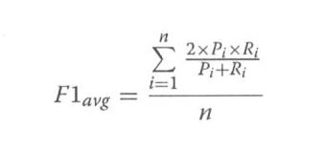
ML algorithms
Results and discussion Evaluation methods Performance of each classification model is estimated based on its averaged F1-score
where Pi is the precision of the ith class, Ri is the recall of the ith class, and n is the number of classes. Pi and Ri are evaluated using 10-fold cross validation. A 10-fold cross validation is applied

Slide 8
Methods Software used for this study is scikit-learn and Google Colab. The classification models selected for categorization are: Logistic Regression, Random Forest, Support Vector Machine and LSTAM Neural Network

Slide 9
Highlights of the implementation details
First, I import dataset from Kaggle to Google Colab, Importing libraries (Pandas, Numpy, Vandersentiment, Nltk, Tfidvectorized) and preprocessing dataset. Second, I have done sentiment analysis and find counts of negative, positive, and neutral tweets. Third I have done lemmatization dataset. Fourth I have done TFIDF vectorization. Finally, I have done ML models with RF, LR , SVM and LSTM Neural Network .
The major techniques which we are using right now are following below
Vader Sentiment Analysis (For sentiment prediction)
Random Forest Classifier (For ML prediction)
Support Vector Machine Classifier (For ML prediction)
Logistic Regression Classifier (For ML prediction)
Neural Networks Classifier (LSTM networks)

Slide 10
Dataset
Dataset that is used in this study are about bitcoin tweets which is collected from Kaggle.com. It has 1048576 rows and 13 columns.Variables were :user_description, user_created,user_folowers,user_friends,user_favorites,user_verified,date,text,hashtags,source,is-retweet.
https://www.kaggle.com/datasets/kaushiksuresh147/bitcoin-tweets

Slide 11
Result
Positive 11288

Slide 12
Result
Positive 11288
Neutral 9821
Negative 3892

Slide 13
ML model | Accuracy
RF | 0.84
SVM | .86
LR | .85
NN | .76

Slide 14
I calculated confusion matrix for all models. As you could see at below ,all models have great accuracy.
For future works, I suggest that richer linguistic analysis, for example, parsing, semantic analysis, and topic modeling with CNN and RNN algorithms to find better results for twitter sentiment analysis.

